Slide 1


EXPLORING
GREY’S ANATOMY
BY EMMY DOORE

Slide 2


Overview
What is Grey’s Anatomy?
Medical drama that first premiered in 2005 on ABC
Follows the surgical residency of a group of five interns and their superiors
As of early March 2024, there are 420 episodes and 19 seasons
Currently the 9th longest running scripted primetime tv series
Why Grey’s Anatomy?
I love the drama
Wanted to know if it was worth it to continue watching
Sources:
https://en.wikipedia.org/wiki/List_of_longest-running_scripted_American_primetime_television_series
https://en.wikipedia.org/wiki/List_of_Grey%27s_Anatomy_episodes#Series_overview

Slide 3





Finding and Preparing my Data
I used BeautifulSoup and CloudScraper in Python (Jupyter Notebook) to webscrape IMDB, Wikipedia, and Fandom.com.
I uploaded my data from Python to Excel to clean and organize my data from Python. I then used PowerBI to explore my data and create my visuals.

Slide 4
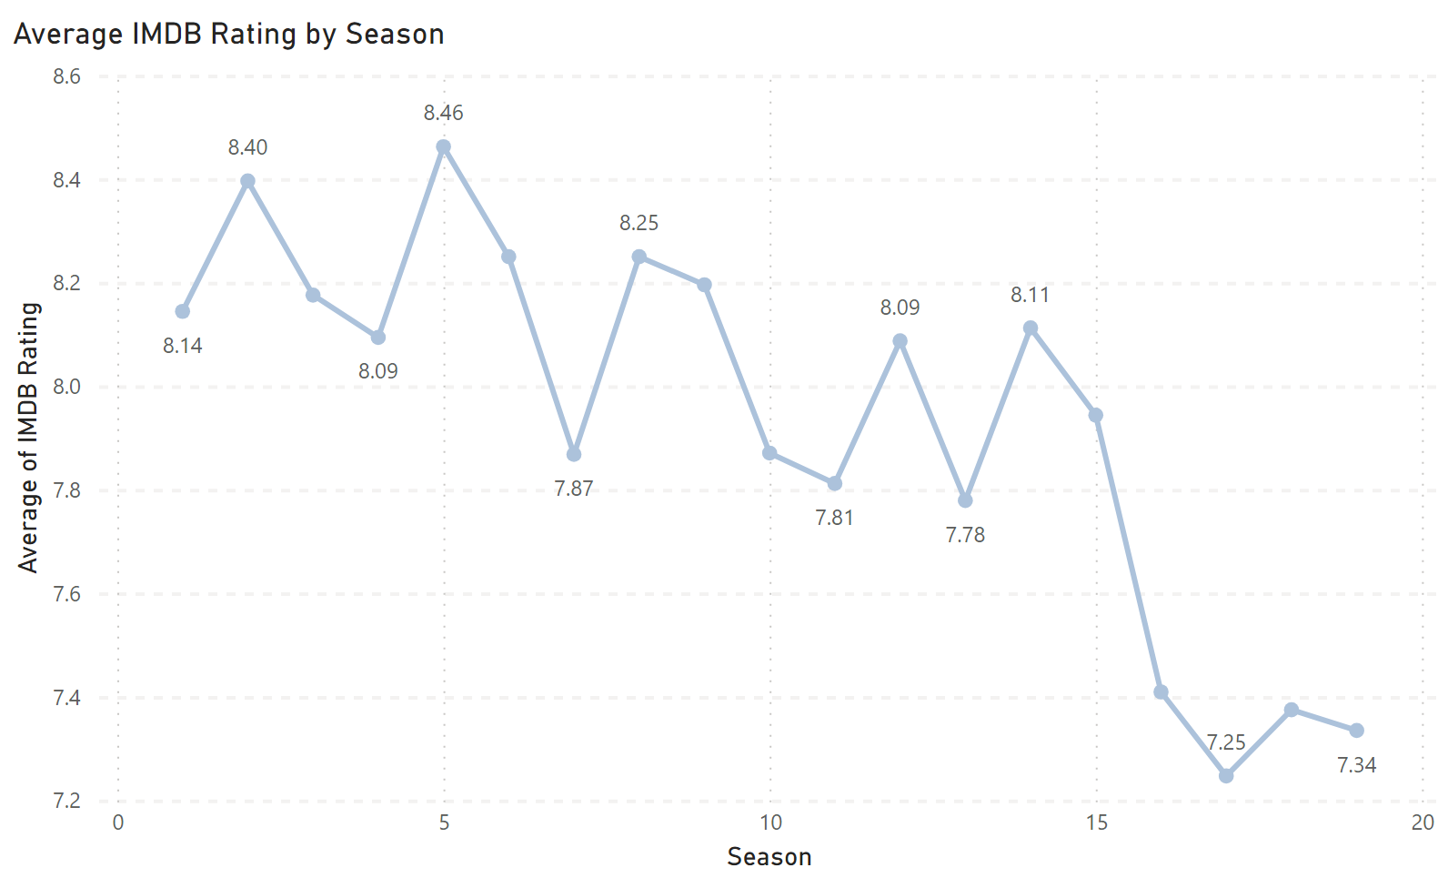
Ratings

Slide 5
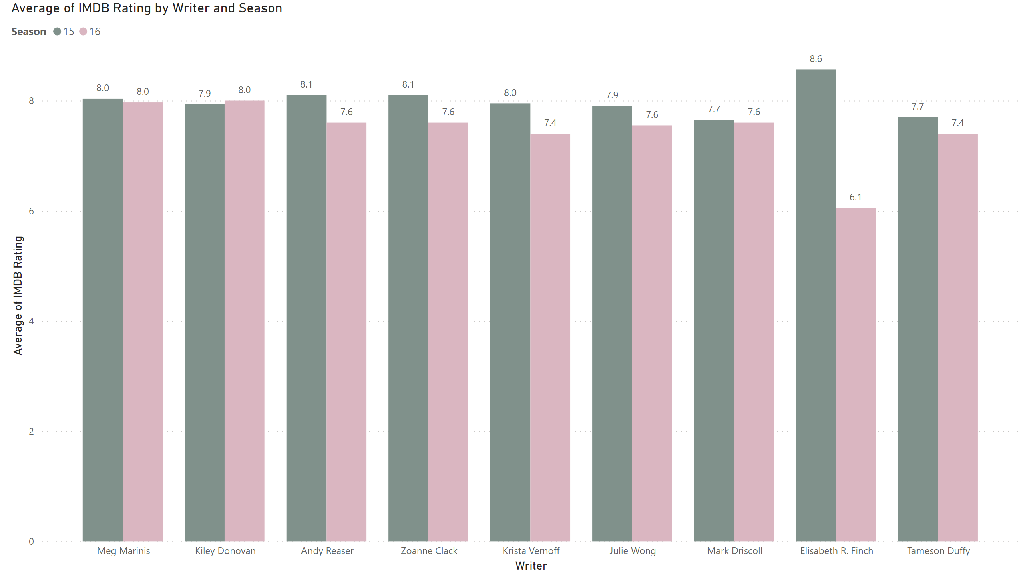
Season 15 and 16 Writers

Slide 6
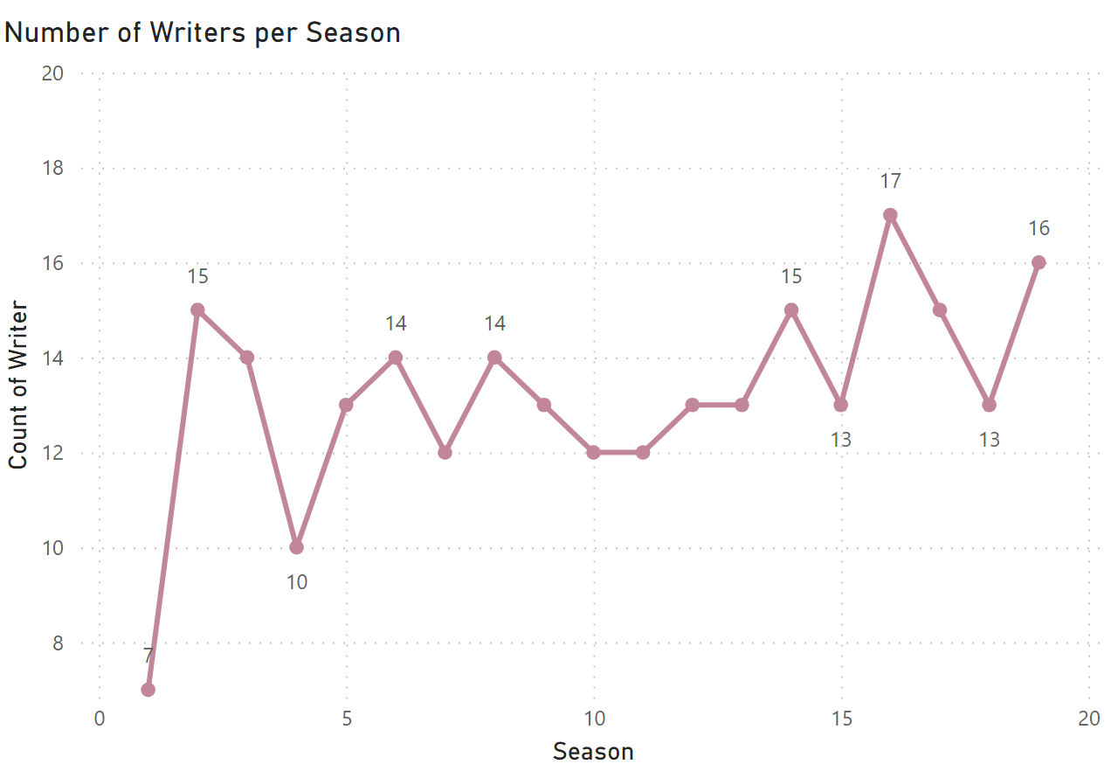
Writers

Slide 7





Ratings
T.R. Knight as George O’Malley
Katherine Hiegl as Izzy Stevens
Sandra Oh as Christina Yang
Ellen Pompeo as Meredith Grey
Justin Chambers as Alex Karev

Slide 8
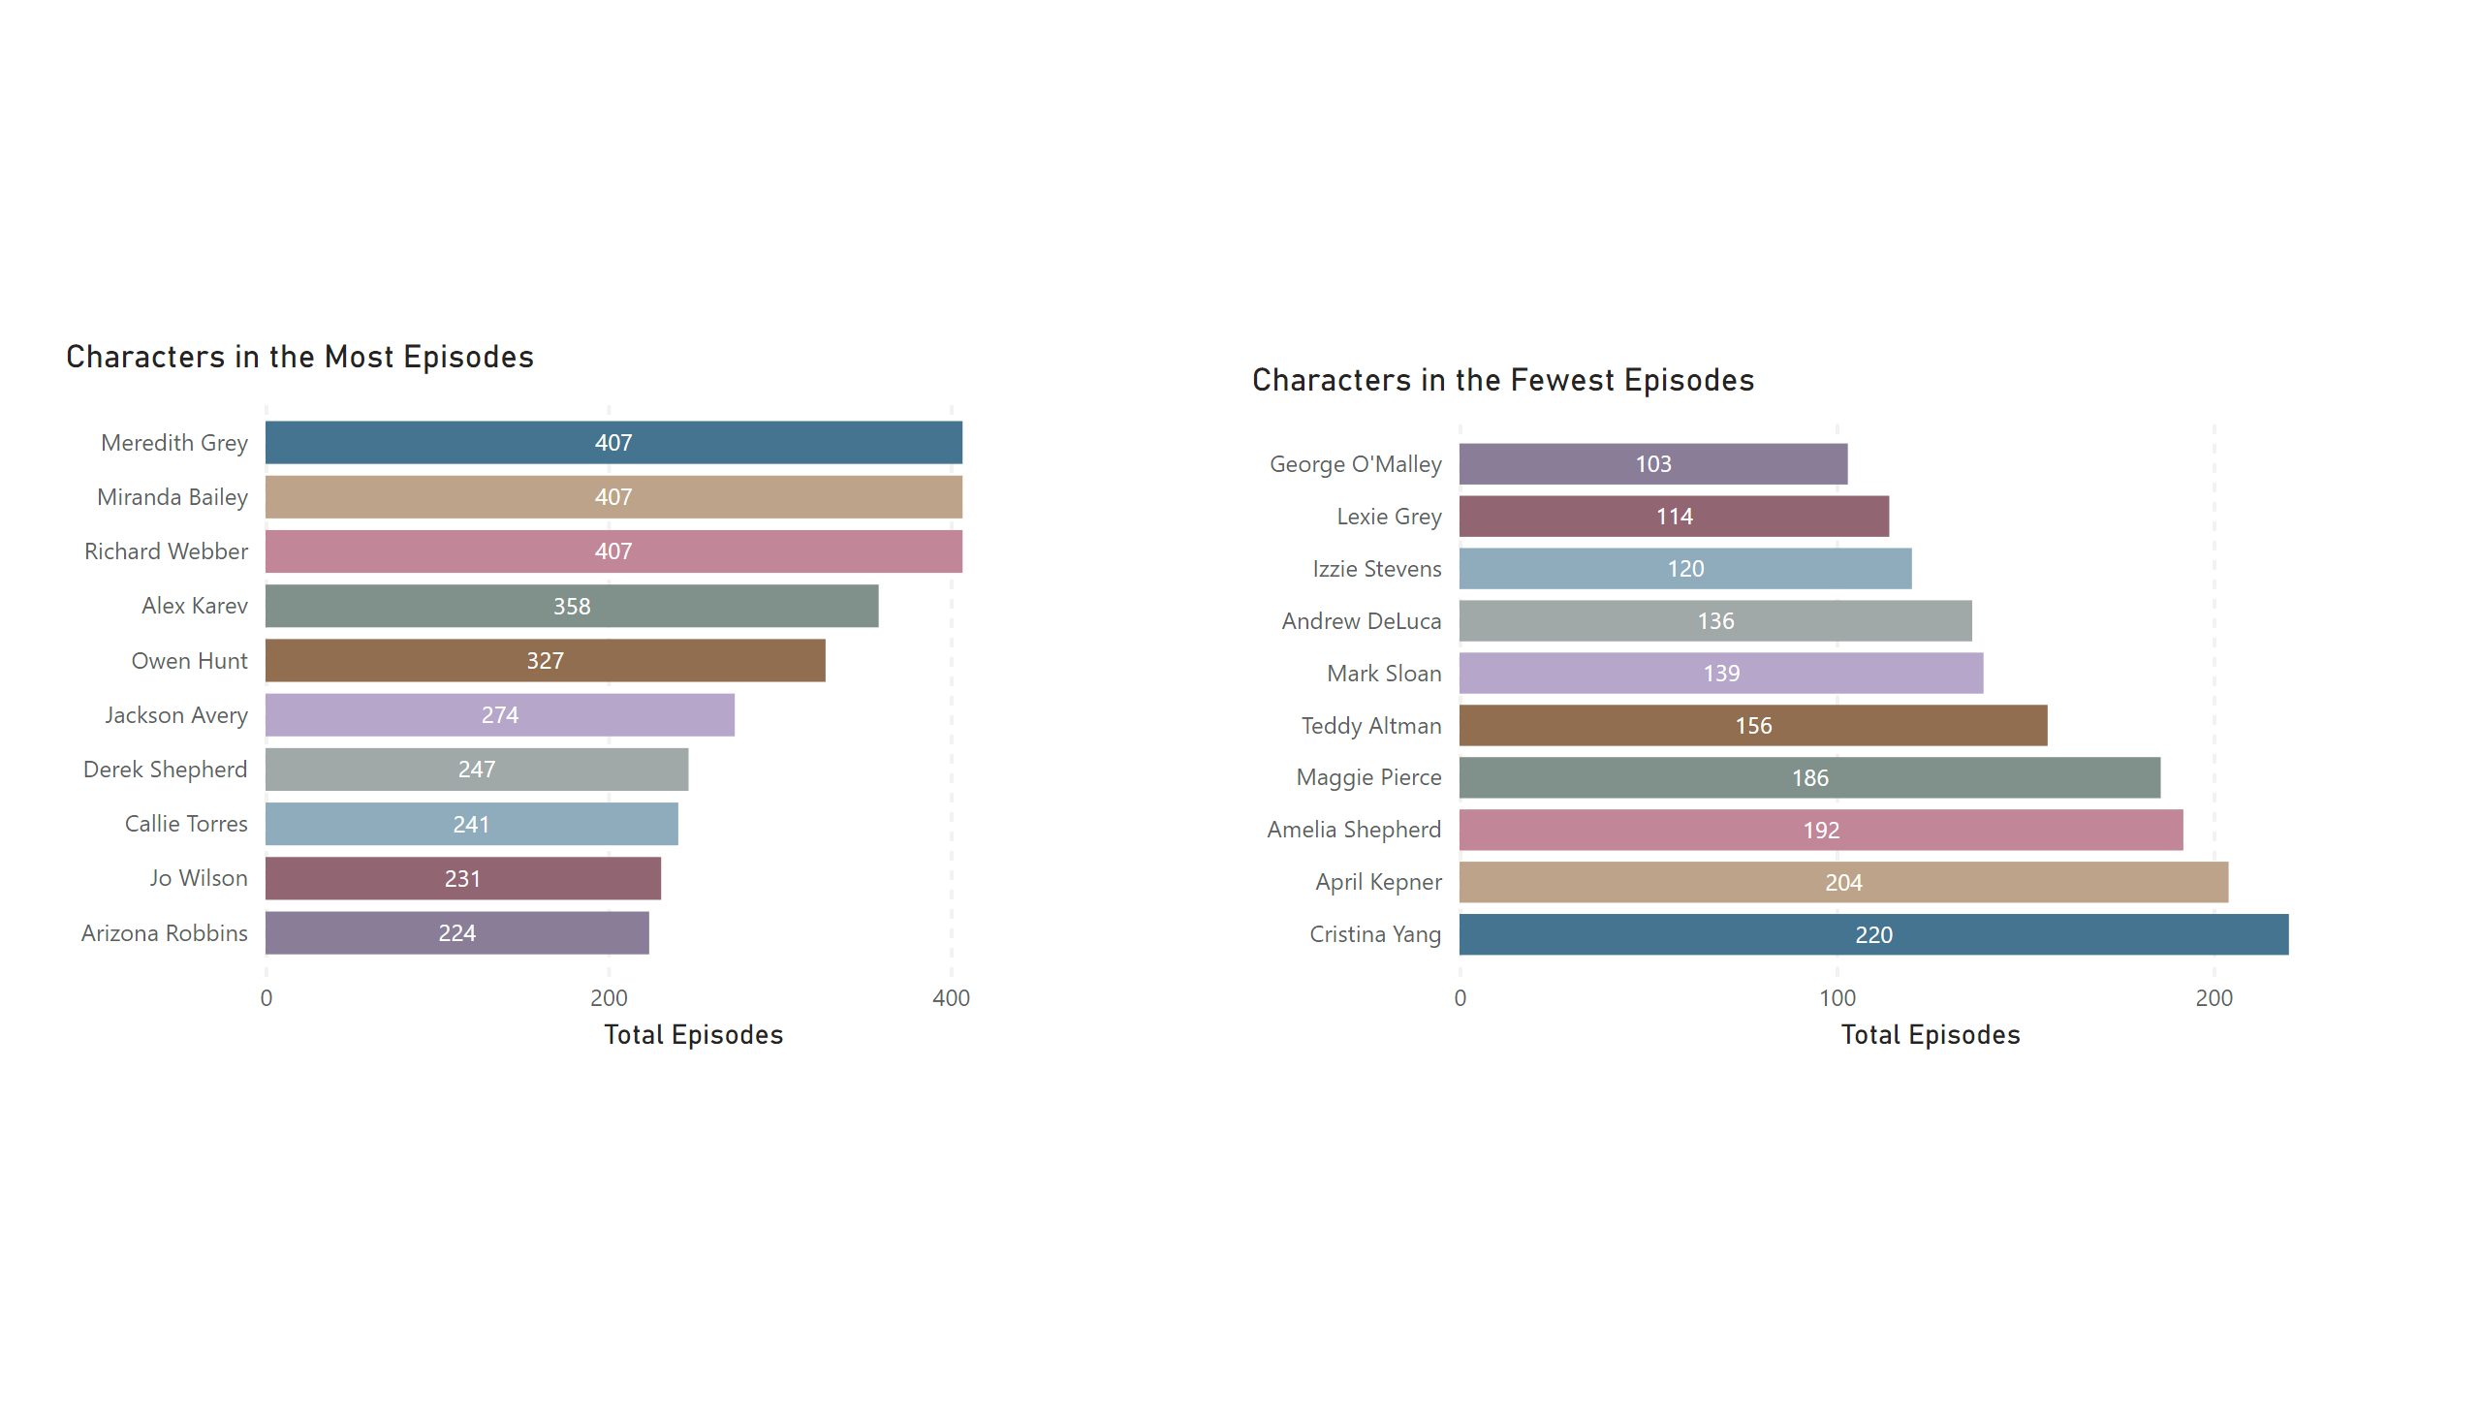
Characters

Slide 9
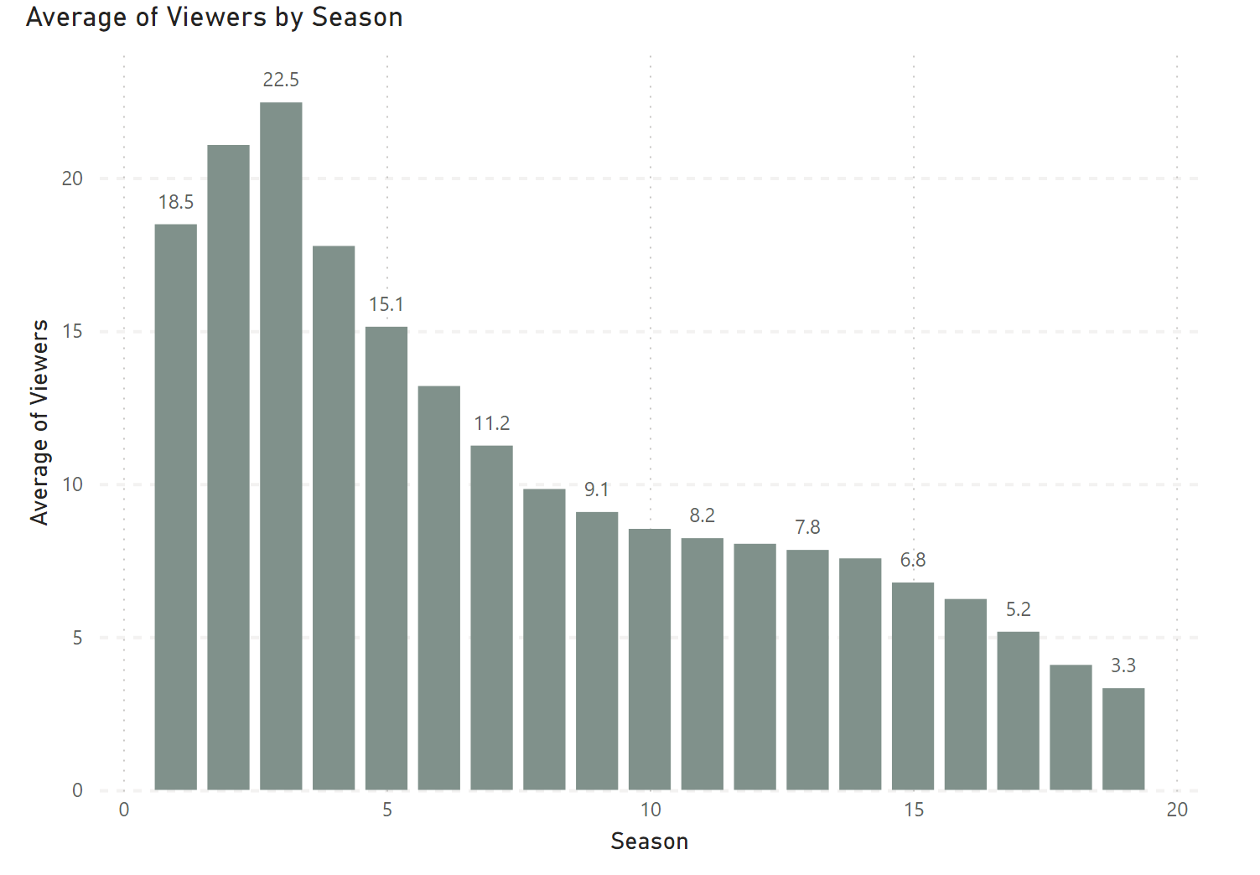
Average Viewers over Time

Slide 10
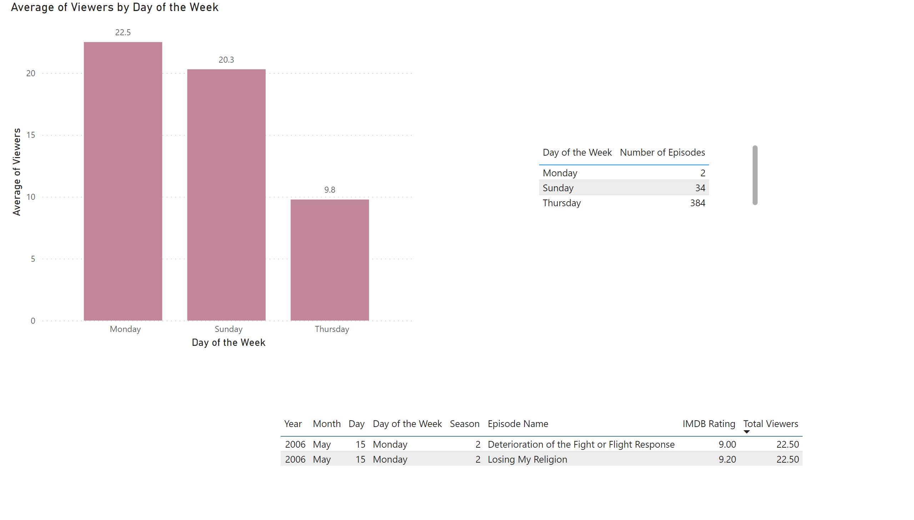
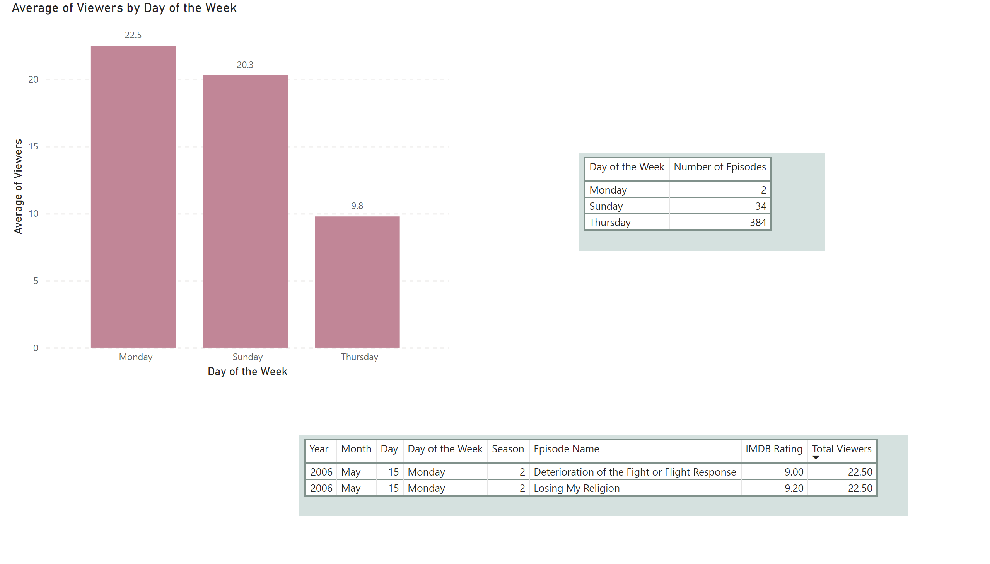
Viewers by Day of the Week

Slide 11
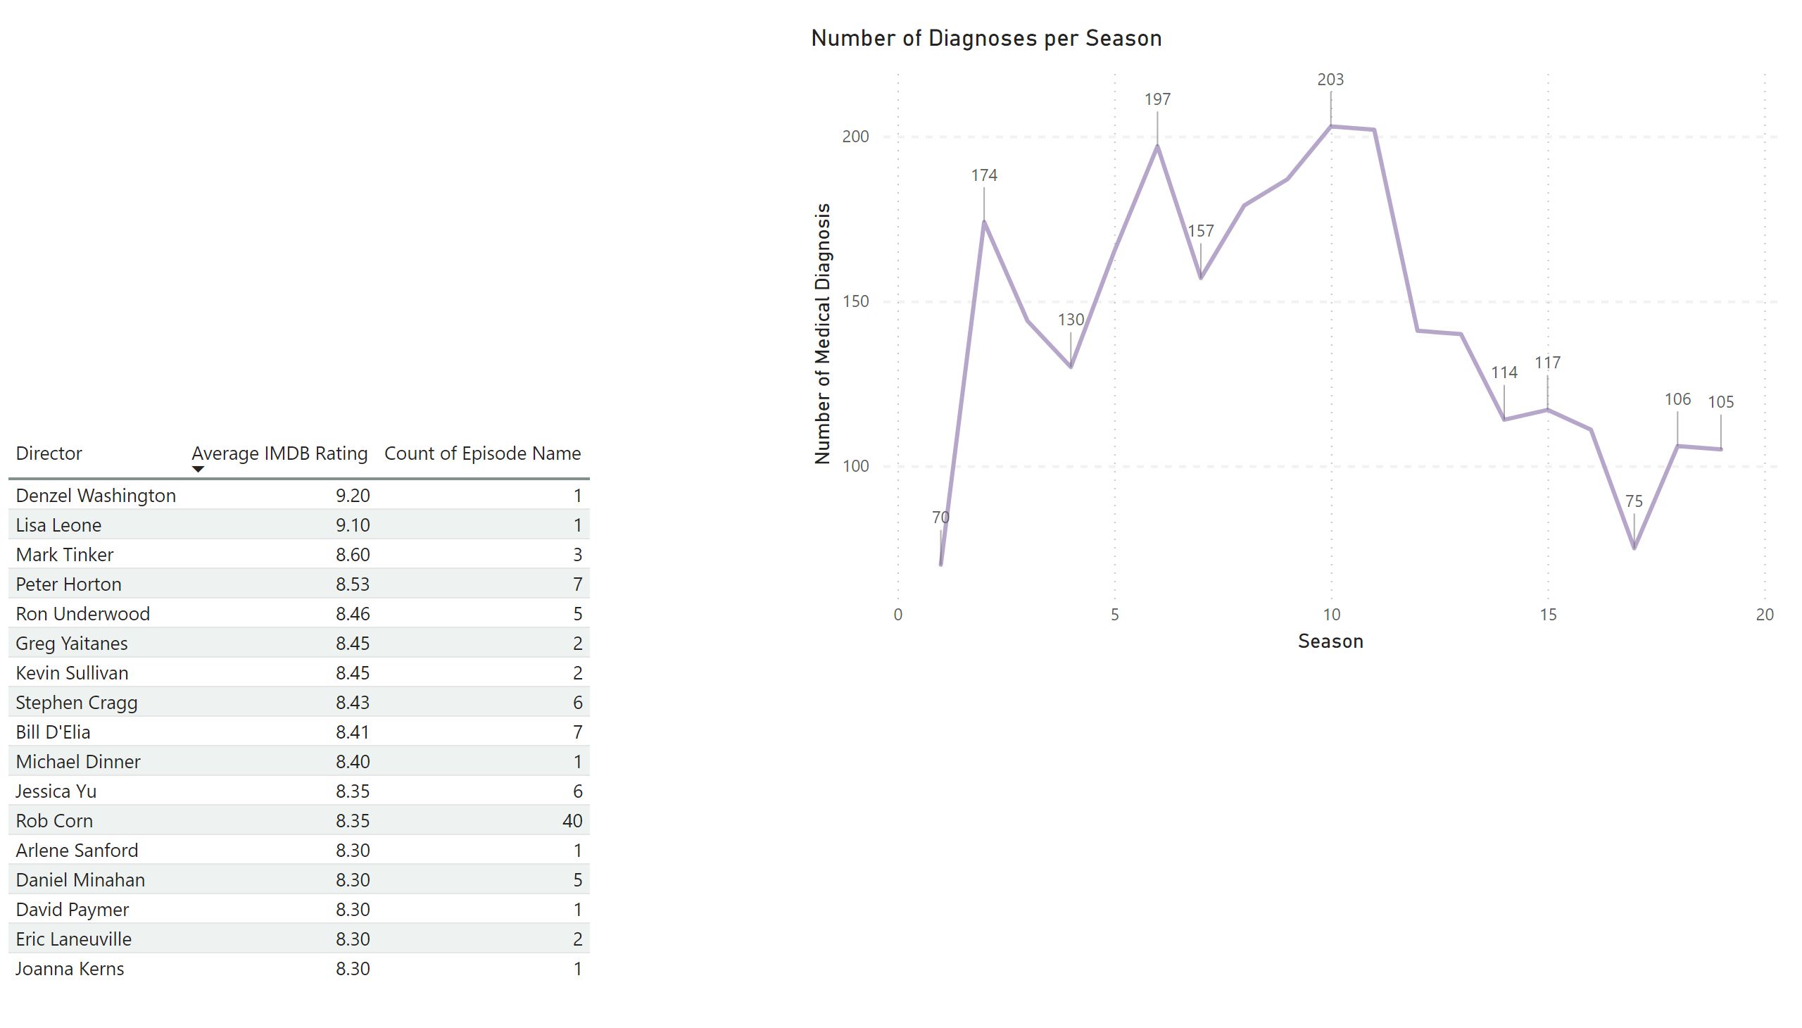
Medical Diagnoses
Aired 11/2020 – 06/2021
Notes:
Pulled every diagnosis per season
Season 11 had the most

Slide 12
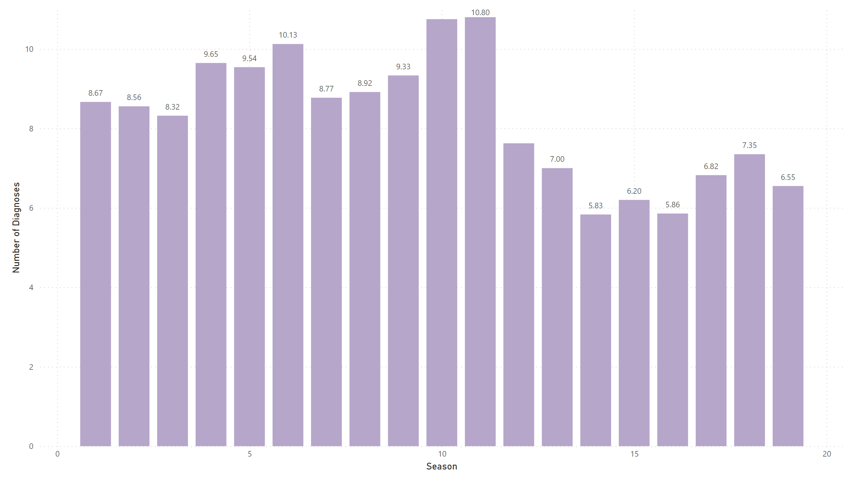
Number of Diagnoses per Episode
10.75
7.63
Notes:
Pulled every diagnosis per season
Season 11 had the most

Slide 13
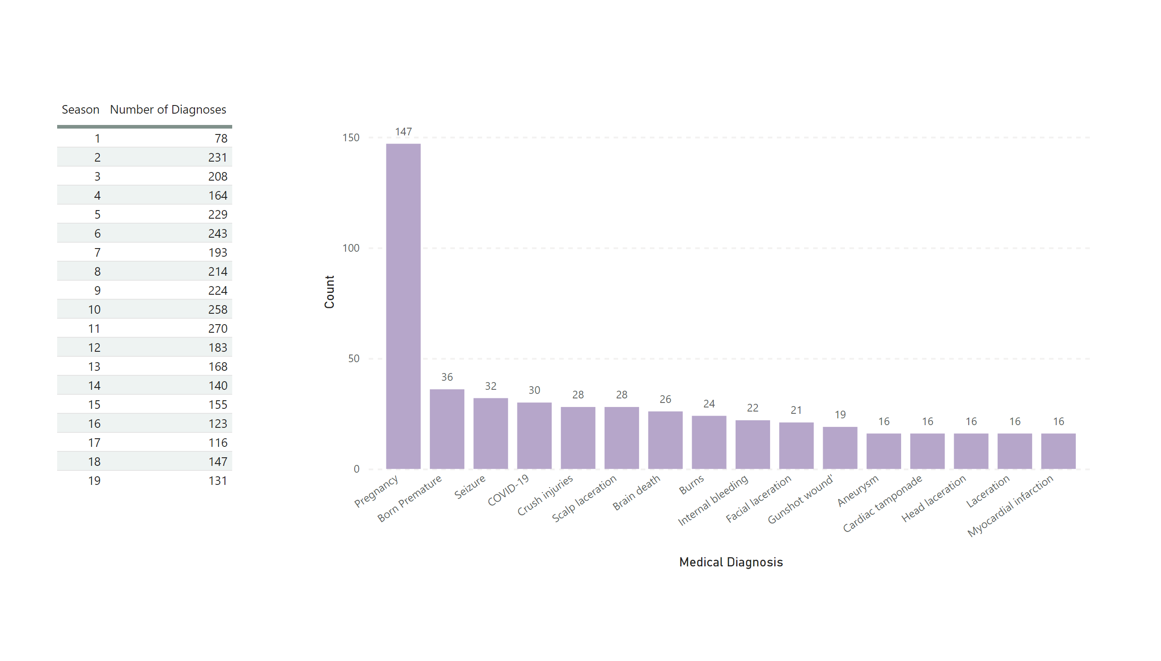
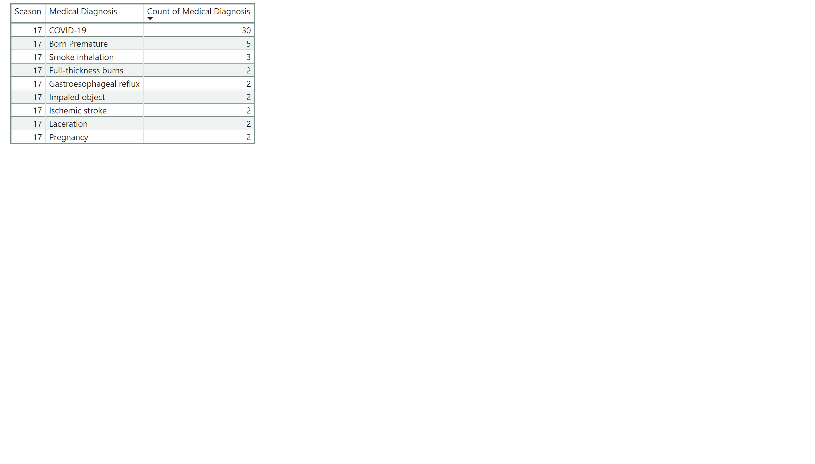
Most Frequent Diagnoses
Notes:
Pulled every diagnosis per season
Season 11 had the most

Slide 14
Medical Diagnoses vs Ratings
Notes:
Pulled every diagnosis per season
Season 11 had the most

Slide 15
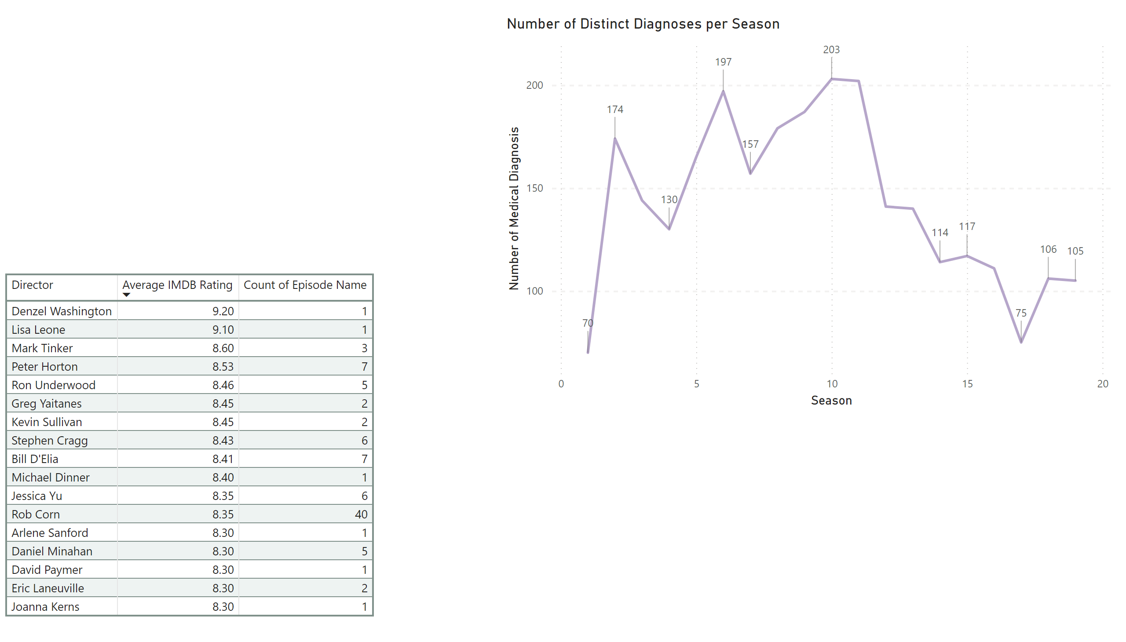
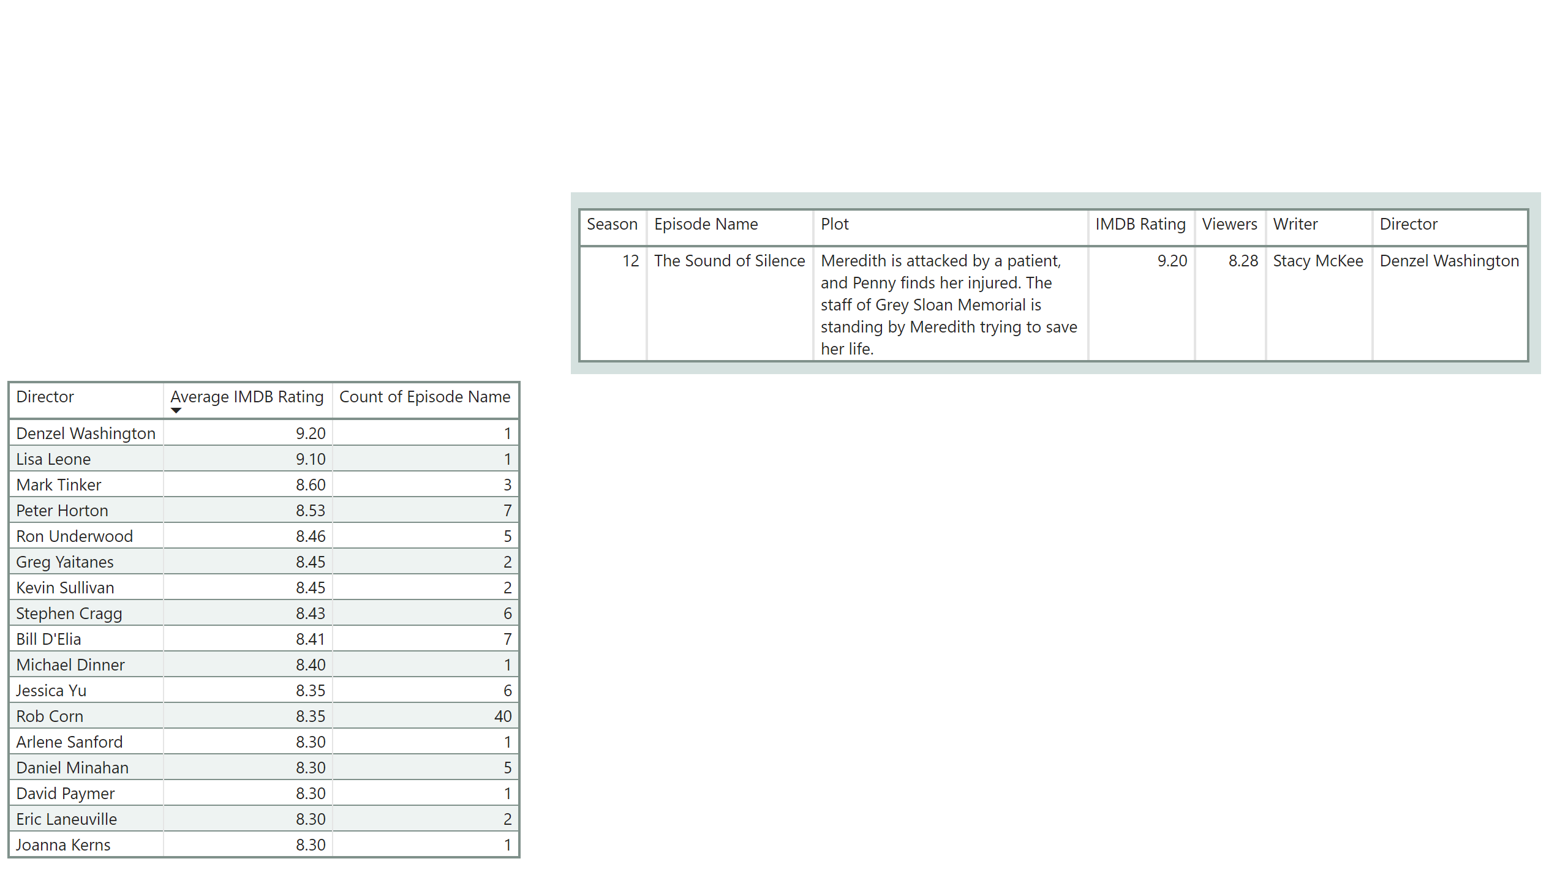
Interesting Fact
Notes:
Pulled every diagnosis per season
Season 11 had the most

Slide 16
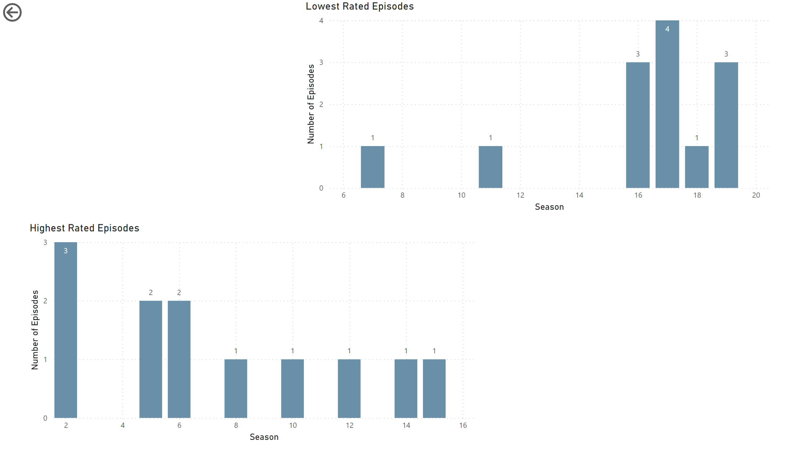
Will I give seasons 11-19 a chance?
Probably not…

Slide 17
Will I give seasons 11-19 a chance?
Probably not…

